Slide 1

Exploring different sequence model

Slide 2
Objectives
Implement the different types of sequence models for Sarcasm Detection- Sarcasm with Bidirectional LSTM
Exploring different sequence model

Slide 3
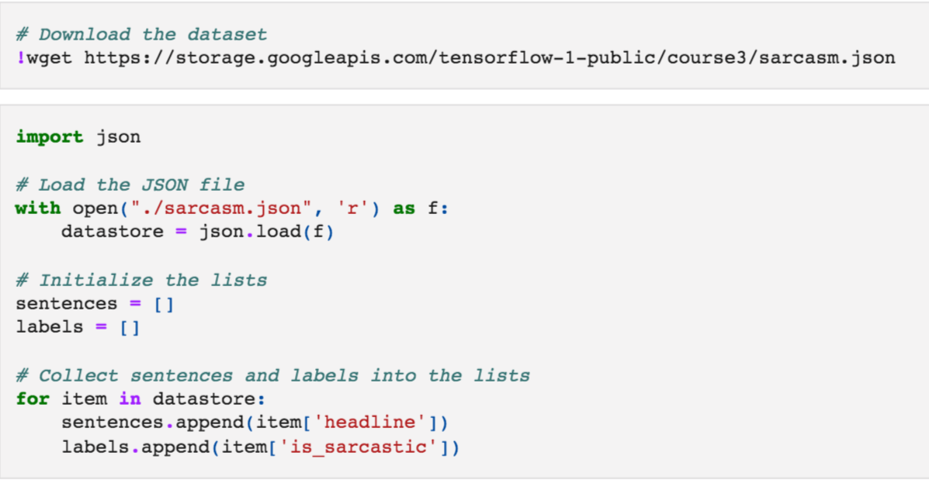
Download the Dataset
Dataset: https://www.kaggle.com/datasets/rmisra/news-headlines-dataset-for-sarcasm-detection
Exploring different sequence model

Slide 4
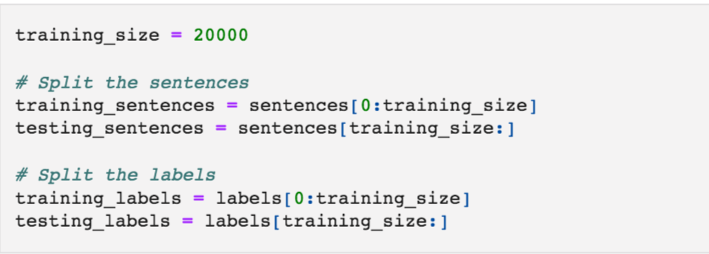
Split the Dataset
Exploring different sequence model

Slide 5
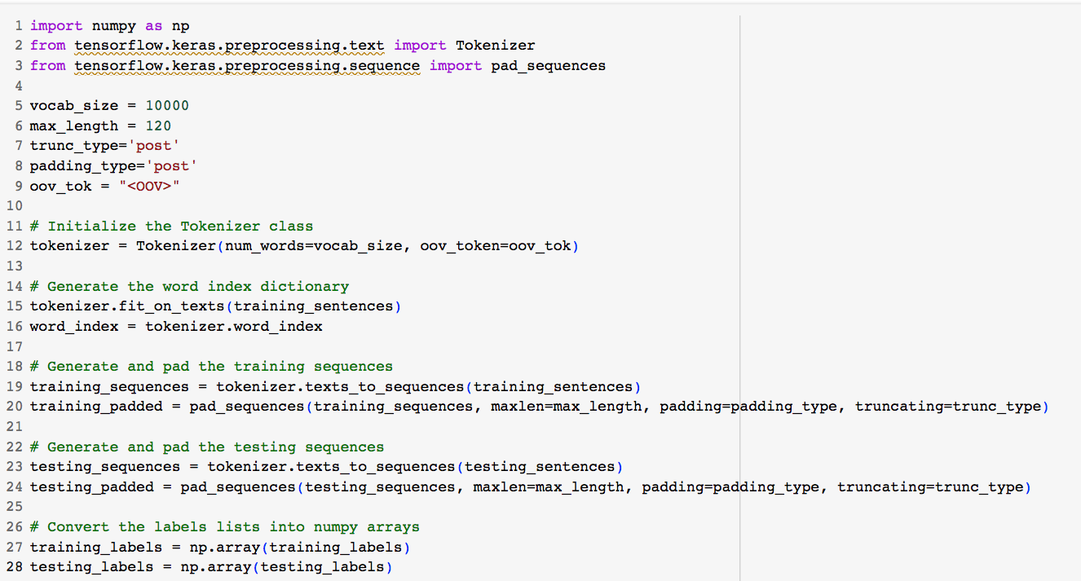
Data preprocessing
Exploring different sequence model

Slide 6
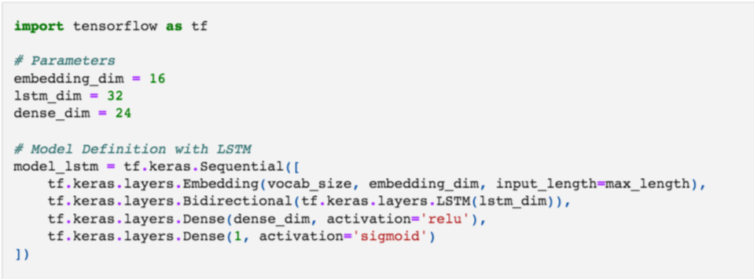
Build model
Exploring different sequence model

Slide 7
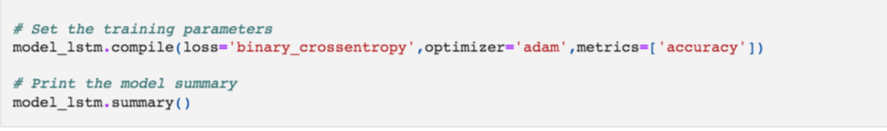
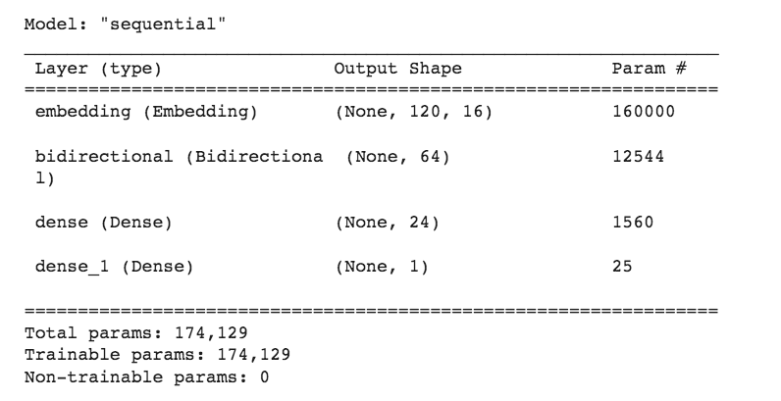
Compile model
Exploring different sequence model

Slide 8
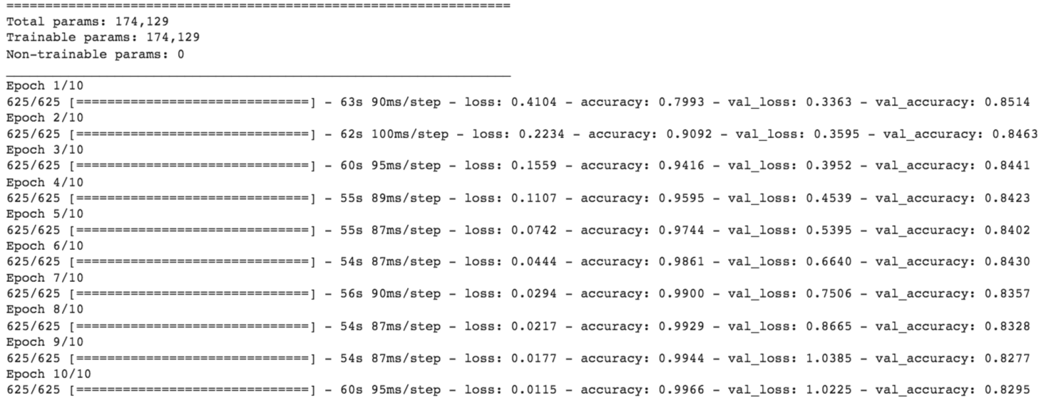
Train model
Exploring different sequence model

Slide 9
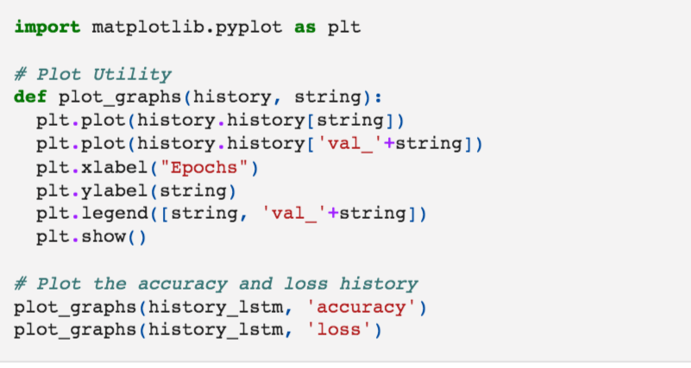
The results
Exploring different sequence model

Slide 10
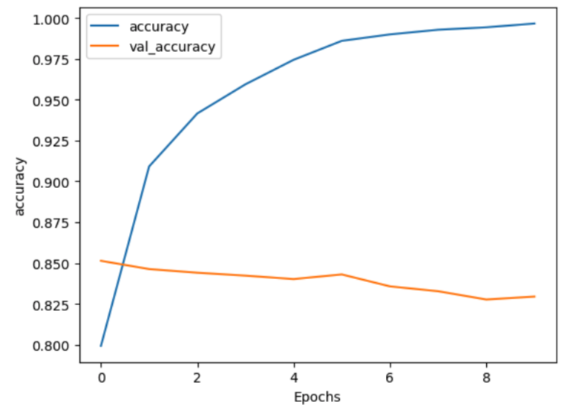
The results
Exploring different sequence model

Slide 11
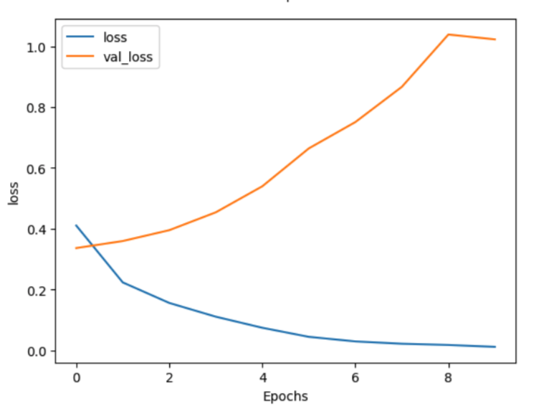
The results
Exploring different sequence model

Slide 12
Task
Student discuss and give opinions about Bidirectional LSTMs
Exploring different sequence model

Slide 13
Summary
Implement the different types of sequence models for Sarcasm Detection- Sarcasm with Bidirectional LSTM
Exploring different sequence model

Slide 14
Q & A
Exploring different sequence model

